Slide 1

An
Industrial Training Report on
Funds Management System
Submitted in partial fulfillment of the requirements for the award of the degree of
Bachelor of Technology
in
Information Technology
(Session 2025-2026)
Submitted to:
Ms. Priya Shekhawat Ms. Shivani Jain (Faculty Coordinators)
Submitted by:
Nirmal Todwal PCE23IT035
DEPARTMENT OF INFORMATION TECHNOLOGY POORNIMA COLLEGE OF ENGINEERING, JAIPUR RAJASTHAN TECHNICAL UNIVERSITY, KOTA
August, 2025

Slide 2
CANDIDATE DECLARATION
I hereby declare that the work which is being presented in this Industrial Training Report entitled “NIDHI-SETU: A Secure Bridge Between Citizens and Government Funds”, in partial fulfillment of the requirements for the award of the Degree of Bachelor of Technology in Information Technology, and submitted to the Department of Information Technology, Poornima College of Engineering, Jaipur, is an authentic record of my own work carried out at Seldom India Technologies, Jaipur, during the session 2024–25 (Odd Semester)
I have not submitted the matter presented in this report anywhere for the award of any other Degree.
Signature of the Student with Name & Reg. No.: Nirmal Todwal (PCE23IT035)
Place: Jaipur
Date: 04/08/2025
Enclosed: Training Certificate from Company
ii

Slide 3

DEPARTMENT OF INFORMATION TECHNOLOGY
Date: 04/08/2025
DEPARTMENT CERTIFICATE
This is to certify that Industrial Training report titled Funds Management System has been submitted by Nirmal Todwal with registration number PCE23IT035 in partial fulfillment for the award of the Degree of Bachelor of Technology in Information Technology during the session 2025-26, Odd Semester. The industrial training work is found satisfactory and approved for submission.
Names & Signatures
Ms. Priya Shekhawat
Ms. Shivani Jain
(Faculty Coordinators- Industrial Training Seminar)
Dr. Gajendra Singh Rajawat
HoD, IT
Date: 04/08/2025 Place: Jaipur
iii

Slide 4
ACKNOWLEDGEMENT
I am sincerely grateful to Ms. Priya Shekhawat and Ms. Shivani Jain, Industrial Training coordinator III Year, Information Technology of Poornima College of Engineering for their invaluable guidance and encouragement throughout the internship. Their mentorship has been instrumental in shaping the innovative aspects of this initiative.
I wish to express my profound gratitude to Dr. Gajendra Singh Rajawat, Head of the
Information Technology Department at Poornima College of Engineering, for his unwavering encouragement, guidance, and motivation during the course of this research.
A special thanks to Dr. Mahesh Bundele, Director and Principal of Poornima College of Engineering, for fostering a conducive learning environment and providing the necessary
resources for this project.
I also wish to acknowledge the visionary leadership of Ar. Rahul Singhi, Director of Poornima Group, whose support has significantly enriched my academic journey and facilitated the successful completion of this project.
This project, Funds Management System is a testament to the collective efforts of all involved, and I sincerely thank everyone for their contributions.
Thank You
Submitted by:
Nirmal Todwal PCE23IT035
4

Slide 5
TABLE OF CONTENTS
Serial No. | Description | Page Number
1. | Title | i
2. | Candidate Declaration | ii
3. | Department Certificate | iii
4. | Acknowledgement | iv
5. | Table of Contents | v
6 | Abstract | 1
7. | Chapter 1: Introduction | 2-4
8. | Chapter 2: Technical Training Platform | 5-7
9. | Chapter 3: Technology Specification | 8-19
10. | Chapter 4: Project Description | 10-13
11. | Chapter 5: Snapshots of the Project | 14-17
12. | Chapter 6: Future Scope of the Project | 18-20
13. | Chapter 7: Conclusion | 21-23
14. | Chapter 8: References | 24
5

Slide 6
ABSTRACT
This project implements a responsive, secure, and citizen-centric platform named NIDHI-SETU: A Secure Bridge Between Citizens and Government Funds. It is designed using modern full stack web technologies — React.js and Tailwind CSS for the front-end interface, ensuring an interactive, user-friendly, and responsive design; Node.js and Express.js for the backend to handle API endpoints, data processing, and system logic; and Firebase for authentication, real-time database management, hosting, and secure data storage.
The system ensures transparency and security in government fund disbursement by linking beneficiary verification with Aadhaar, death registries, and life certificate databases. It enables real-time verification through 3D face authentication (via Supabase) and voice verification (via Twilio AI Bot) to confirm the liveness of beneficiaries before releasing funds. Admin users can access secure dashboards to monitor verification status, review flagged cases, manage records, and generate analytical insights.
Core features include secure authentication, real-time beneficiary verification, AI-driven fraud detection, role-based access control, and data encryption for integrity and compliance. The architecture demonstrates seamless integration of AI and web technologies in a government-oriented application, showcasing strong understanding of RESTful APIs, cloud services, and asynchronous data handling.
The project reflects a practical implementation of Full Stack Web Development concepts, combining usability, reliability, and scalability. It serves as a prototype for e-Governance solutions aimed at improving transparency and efficiency in social security fund distribution.
Key features:
Responsive React UI with reusable components.
Firebase Authentication for secure sign-in/sign-up.
Vehicle with search, filters, and detailed pages.
Booking flow with availability checks and confirmations.
Admin dashboard: add/edit/remove vehicles, view/manage bookings.
Node.js APIs for server-side validation and business rules.
Realtime DB for persistent storage; optional hosting on Firebase.

Slide 7
Chapter 1
Introduction
NIDHI-SETU is a web-based platform developed to ensure secure, transparent, and efficient disbursement of government welfare funds to eligible beneficiaries. In the modern era of digital governance, where technology plays a vital role in improving public service delivery, this project addresses a critical challenge — preventing fraudulent or duplicate transactions in welfare schemes while preserving the dignity and rights of genuine citizens.
The primary objective of this project is to design and implement an automated, user-friendly, and intelligent verification system that connects citizens with government departments through a secure digital bridge. NIDHI-SETU simplifies and digitizes the verification and fund transfer process using AI-powered authentication, including 3D face verification, voice recognition, and real-time database matching.
Traditionally, the process of verifying beneficiaries for pension or welfare schemes involved manual verification, physical document submission, and delayed data updates. This often led to errors such as payments to deceased or ineligible individuals and identity mismatches. The introduction of NIDHI-SETU overcomes these limitations by providing a centralized, automated, and transparent online platform that integrates with Aadhaar, death registries, and life certificate databases to ensure only eligible, living beneficiaries receive government aid.
This project is built using a Full Stack Web Development approach, employing modern technologies such as React.js and Tailwind CSS for the front-end, Node.js and Express.js for backend services, and Firebase for authentication, real-time database, and hosting. The system also integrates Supabase for 3D face verification and Twilio AI for voice-based liveness detection.
1.1 Purpose of the System
The main purpose of developing the NIDHI-SETU System is to create a secure and intelligent digital platform that bridges the gap between citizens and government welfare departments. The system aims to make the process of fund disbursement, beneficiary verification, and record management more transparent, efficient, and tamper-proof through the use of modern web technologies and AI-driven automation.
For government administrators, the platform provides a centralized management system that simplifies beneficiary verification, prevents fraudulent or duplicate payments, and ensures that social welfare funds reach only eligible and living recipients. This reduces administrative workload, minimizes human errors, and enhances operational efficiency across departments.

Slide 8
  Objectives of the Project
The primary objectives of the NIDHI-SETU System are:
To design and develop a secure, web-based beneficiary verification and fund disbursement platform using modern full stack web technologies.
    To automate the verification process by integrating real-time data from Aadhaar, death registries, and life certificate databases.
    To prevent fraudulent or duplicate fund transfers by ensuring only eligible and living beneficiaries receive welfare payments
    To implement AI-based 3D face and voice authentication modules for liveness verification using Supabase and Twilio AI.
  Full Name of the Technical Training/Course
Full Stack Developer Internship – NIDHI-SETU System
  Training Platform
In-Person Corporate Internship at Seldom India Technologies , Jaipur
  Training Starting Date
16th June 2025
  Training Ending Date
31st July 2025
  Total Training Duration
Total Days: 45
Hours per Day: 5

Slide 9
Total Hours: 225
1.8 Date of Certification
31st July 2025
1.9 Conclusion
The training provided a comprehensive foundation in Full Stack Web Development and Cloud Integration using modern technologies. By applying the concepts and tools learned during the internship, the NIDHI-SETU project was successfully designed and implemented. The project demonstrates the ability to build a secure, AI-integrated, and scalable web platform that ensures transparency and efficiency in government fund disbursement.
Through this project, I gained practical experience in frontend development using React.js and Tailwind CSS, backend services using Node.js and Express.js, and real-time authentication and data handling using Firebase. Additionally, integrating AI-based verification modules such as Supabase (3D Face Authentication) and Twilio AI (Voice Verification) enhanced my understanding of how advanced technologies can be applied to real-world e-governance solutions.

Slide 10
Chapter 2
Technical Training Platform
2.1 Introduction
The Technical Training Platform serves as a vital bridge between theoretical learning and practical implementation in modern software development. The training was conducted at Seldom India Technologies, Jaipur, a professional corporate environment that provided hands-on exposure to Full Stack Web Development and cloud integration practices. The main objective of the training was to equip participants with practical experience in utilizing modern web technologies and AI-driven tools through the development of a real-world project — NIDHI-SETU.
The training covered various aspects of full stack development, including front-end design using React.js and Tailwind CSS, server-side programming with Node.js and Express.js, and real-time data management and authentication using Firebase. Participants were also introduced to AI-powered modules, integrating Supabase for 3D facial recognition and Twilio AI for voice-based verification, enabling a deeper understanding of how artificial intelligence can enhance e-governance platforms.
2.2 Reason of Selecting this Platform
The decision to select Seldon India Technologies as the technical training platform was based on several key factors:
Industry-Oriented Training: The platform offers training that is closely aligned with current industry requirements, ensuring practical knowledge applicable in real-world projects.
Hands-On Learning: Participants get the opportunity to work on live projects, which helps in understanding the end-to-end software development lifecycle.
Expert Mentorship: Experienced professionals provide guidance, support, and insights throughout the training program.

Slide 11
Use of Modern Technologies: The platform emphasizes the use of modern web development technologies such as React.js, Node.js, and Firebase, which are essential for full-stack development.
Exposure to Corporate Environment: Training in a corporate setup helps participants understand professional workflows, project management practices, and collaboration within a team.
2.3 Profile of Organization Providing the Course
Seldon India Technologies is a professional IT training and consulting organization that specializes in providing industry-relevant technical courses and corporate internships. The organization is committed to bridging the gap between academic knowledge and industry requirements by offering hands-on training programs.
The key features of the organization include:
Comprehensive training programs in web development, cloud technologies, and full- stack development.
Focus on practical project-based learning to ensure skill development.
Experienced faculty with expertise in modern software technologies.
Access to professional tools, resources, and live project scenarios for real-time learning.
Seldon India Technologies has trained numerous students and professionals, enabling them to acquire skills necessary for building successful careers in the IT industry.
2.4 Technical Profile of the Instructor
The instructor for this training program was a senior software professional with extensive experience in full-stack web development and cloud technologies. Key highlights of the instructor’s profile include:

Slide 12
Expertise: Proficient in HTML, CSS, JavaScript, React.js, Node.js, Firebase, and other modern web development technologies.
Industry Experience: Several years of experience working in corporate projects and implementing real-world web applications.
Project Guidance: Assisted participants in understanding project requirements, designing the system architecture, and implementing functional features in the Car Rental System project.
Mentorship: Provided continuous support in debugging, code optimization, and best practices in software development.
Training Approach: Focused on hands-on learning, real-time problem solving, and enhancing both technical and professional skills of the participants.
The instructor played a pivotal role in ensuring that the training was practical, engaging, and aligned with current industry standards.
2.5 Conclusion
The training program at Seldom India Technologies, Jaipur provided a structured and professional learning environment focused on Full Stack Web Development and Cloud Integration. Participants gained valuable hands-on experience in front-end and back-end development, database management, and deployment of web-based applications using modern technologies.
Under expert mentorship and through project-based learning, the trainees successfully developed the NIDHI-SETU System — an AI-integrated web platform designed to ensure secure and transparent government fund disbursement. The project served as a practical application of key concepts such as React.js-based UI design, Node.js server-side development, Firebase authentication and real-time data handling, and AI-driven verification using Supabase and Twilio AI.

Slide 13
Chapter 3
Technology Specification
  Introduction
The training program at Seldom India Technologies, Jaipur was focused on Full Stack Web Development, providing practical, hands-on experience in designing, developing, and deploying real-world web applications. The primary objective of this training was to strengthen participants’ technical skills in both frontend and backend development, while also introducing them to AI integration and cloud-based services.
As part of this training, participants worked on the NIDHI-SETU project — a secure, AI-driven web platform designed to ensure transparency and accuracy in government welfare fund disbursement. The system enables real-time beneficiary verification through 3D face authentication (Supabase) and voice verification (Twilio AI), while administrators can efficiently monitor, validate, and manage fund distribution through an interactive dashboard. This project served as a comprehensive learning experience that combined theoretical understanding with practical, real-world implementation.
The training emphasized a project-based learning approach, ensuring that participants not only understood programming concepts but also their practical application in a corporate development environment. Throughout the program, trainees gained exposure to the complete software development lifecycle (SDLC) — including requirement analysis, system design, implementation, testing, and deployment.
  Technology Description
The NIDHI-SETU project was developed using a powerful combination of modern web technologies, AI integration tools, and cloud services to ensure scalability, performance, and security.
React.js:
Used as the front-end library for building a responsive and component-driven user interface, ensuring a smooth and interactive user experience for both beneficiaries and administrators.
Tailwind CSS:
Applied for modern, utility-first styling to create a clean, mobile-responsive, and visually appealing interface without compromising performance.
Node.js:
Served as the server-side runtime environment, handling backend logic, API communication, and processing real-time data requests efficiently.
Express.js:
Used for creating RESTful APIs and managing routes between the front-end and backend, ensuring reliable communication and modular development.
Firebase:
Utilized for authentication, real-time database management, and cloud hosting. It enables secure login, role-based access control, and data synchronization between users and the server.

Slide 14
The integration of these technologies allowed participants to create a full-stack web application that is scalable, secure, and responsive. The training covered best practices in coding, UI design, and database management, ensuring that participants were well-equipped to handle professional software projects.
3.3 Exposure Level
The training provided comprehensive exposure to both the technical and practical aspects of modern full-stack web development, emphasizing the integration of front-end, back-end, and cloud-based technologies.
Front-End Development:
Participants learned to design and develop responsive, accessible, and interactive user interfaces using React.js and Tailwind CSS, ensuring a seamless user experience for beneficiaries and administrators.
Back-End Development:
Exposure to Node.js and Express.js enabled trainees to handle server-side logic, create RESTful APIs, and integrate backend functionality with databases and verification modules.
Cloud and AI Integration:
The training incorporated Firebase for authentication, real-time database management, and secure cloud hosting, while Supabase and Twilio AI were used to implement 3D face verification and voice-based authentication, offering real-world experience with AI-driven cloud applications.
Project-Based Learning:
Working on the NIDHI-SETU project allowed participants to experience end-to-end software development, including requirement analysis, system design, coding, testing, deployment, and AI model integration, thereby bridging theory with practical implementation.
that participants gained hands-on technical proficiency, analytical problem-solving skills, and a complete understanding of Full Stack Web Development, preparing them for real-world projects in software development and e-governance solutions.
3.4 Conclusion
The technical training at Seldom India Technologies, Jaipur provided a structured and professional learning environment that effectively bridged the gap between theoretical knowledge and practical implementation. Through this program, participants gained in-depth exposure to Full Stack Web Development, cloud integration, and AI-based system development, along with essential project management techniques.
The NIDHI-SETU project served as a practical platform for applying the concepts learned during the training. It allowed participants to design and develop a secure, intelligent, and responsive web application focused on ensuring transparency and authenticity in government welfare fund distribution.
The training enhanced not only technical expertise in tools such as React.js, Node.js, Express.js, Firebase, Supabase, and Twilio AI, but also strengthened participants’ analytical thinking, problem-solving abilities, and teamwork skills. By combining real-world problem statements with modern development.

Slide 15
Chapter 4
Project Description
  Introduction
The development of the NIDHI-SETU System represents the practical implementation of the concepts learned during the Full Stack Web Development training at Seldom India Technologies, Jaipur. This system automates and secures the process of beneficiary verification and government fund disbursement, reducing manual intervention, improving operational efficiency, and enhancing user trust in public service systems.
The project was developed using an integrated stack of front-end, back-end, AI, and cloud-based technologies, giving participants hands-on experience in real-world software development and deployment.
The primary goal of this project is to design and implement a secure, scalable, and intelligent web application that ensures only eligible and living beneficiaries receive welfare payments. The system includes features such as real-time authentication, AI-driven liveness detection, voice-based verification, and role-based access control for both beneficiaries and administrators.
  Project Description
The NIDHI-SETU System is a web-based platform designed to ensure secure and transparent disbursement of government welfare funds. It operates through two main user roles:
Beneficiary/User: Performs login, undergoes AI-based face and voice verification, and checks real-time fund status.
Administrator: Manages beneficiary records, monitors verification results, handles flagged cases, and controls fund approvals through a secure dashboard.
Key Features:
      Responsive and interactive user interface using React.js.
      Secure authentication and role-based access control using Firebase Authentication.
      Real-time data management with Firebase, allowing instant updates on bookings and vehicle availability.
      Backend logic handled by Node.js to ensure data validation, processing of business rules, and API management.
      Mobile-friendly design ensuring accessibility on multiple devices.
The system significantly reduces manual work, prevents booking conflicts, and provides an organized platform for vehicle and user management.

Slide 16
4.3 System Analysis and Design
The system was analysed and designed using standard software engineering principles:
Requirement Analysis: Understanding the functional and non-functional requirements of the system, including user roles, booking workflow, vehicle management, and security features.
System Design:
  Front-End Design: UI was designed using React.js components to provide a seamless, single-page application experience.
  Back-End Design: Node.js handles server-side processing, API endpoints, and integration with Firebase.
  Database Design: Firebase stores user, booking, and vehicle data in a structured and scalable manner.
Flow Diagrams and Use Cases: Use case diagrams, flowcharts, and wireframes were prepared to visualize the system workflow, including user actions, admin tasks, and data flow.
Security and Validation: Authentication, authorization, and input validation were incorporated to maintain data integrity and prevent unauthorized access.
The design ensures modularity, scalability, and maintainability, allowing the system to be enhanced in the future with additional features like payment integration or vehicle tracking.
4.5 System Development/Implementation
The development phase involved translating the design into a working system using the following technologies:
Front-End Implementation:
  HTML, CSS, and JavaScript were used to structure and style the web pages.
  React.js was employed for component-based architecture, state management, and dynamic rendering.
Back-End Implementation:
  Node.js handled server-side logic, routing, and API endpoints.
  RESTful APIs were developed to connect the frontend with Firebase services.
Database and Cloud Integration:
  Firebase was used for real-time database storage.

Slide 17
Firebase Authentication provided secure login for users and admins.
Cloud storage and hosting ensured data persistence and application availability.
Features Implemented:
  User registration and login.
  Vehicle listing with search and filter functionality.
  Booking management with real-time updates.
  Admin dashboard for vehicle and booking management.
  Form validation, error handling, and responsive design.
The system was developed following best practices in coding, version control, and modular programming to ensure maintainability and scalability.
4.6 System Testing/Maintenance
Testing:
The system underwent multiple levels of testing to ensure quality, reliability, and functionality:
Unit Testing: Individual modules, components, and functions were tested separately.
Integration Testing: Interaction between frontend, backend, and Firebase services was verified.
System Testing: Complete system functionality, including booking workflow, authentication, and admin operations, was tested.
User Acceptance Testing (UAT): End-users tested the application for usability, responsiveness, and overall performance.
Maintenance:
The system is designed for easy maintenance and future upgrades. Firebase’s real-time database
ensures minimal downtime, and modular React and Node.js code allows developers to add new features, fix bugs, and scale the system efficiently. Documentation was prepared to assist future developers in understanding the system architecture and implementation.
4.7 Conclusion
The development of the Car Rental System successfully demonstrates the application of full- stack web development concepts in a practical project. The system integrates React.js, Node.js, and Firebase to provide a responsive, secure, and scalable solution for vehicle rental management.

Slide 18
Through this project, participants gained experience in system analysis, design, development, testing, and deployment, reinforcing their understanding of modern web technologies. The system reduces manual effort, ensures real-time data accuracy, and offers a professional platform for both customers and administrators. Overall, the project highlights the effective application of training concepts in creating a functional, industry-relevant web application.

Slide 19
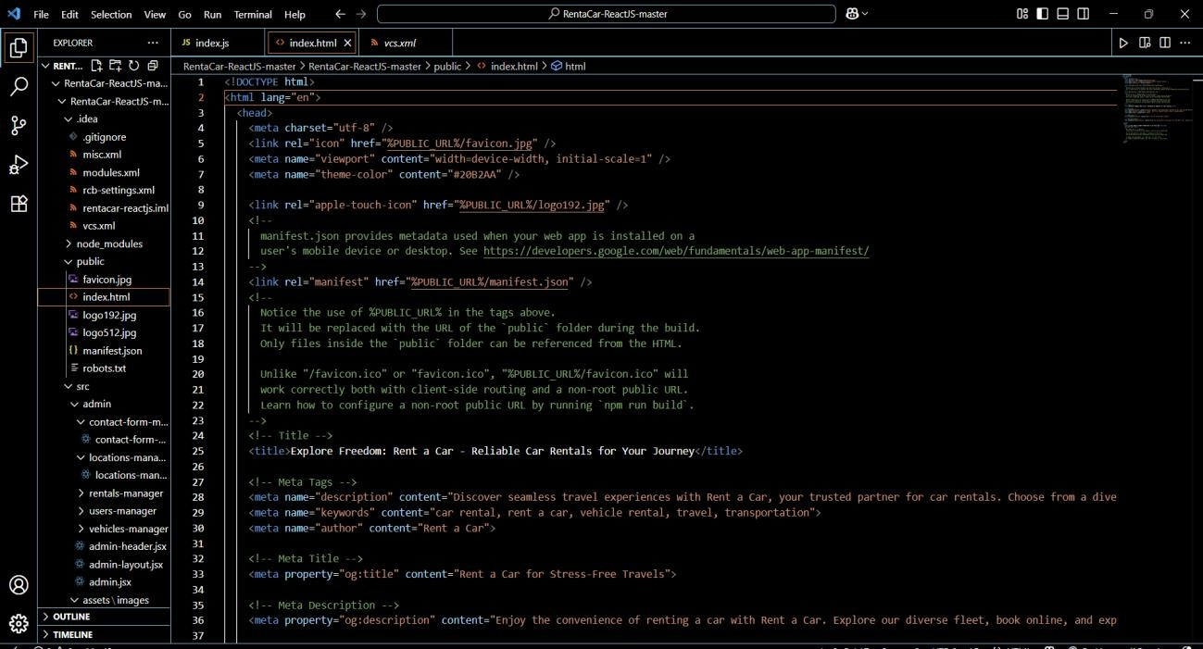
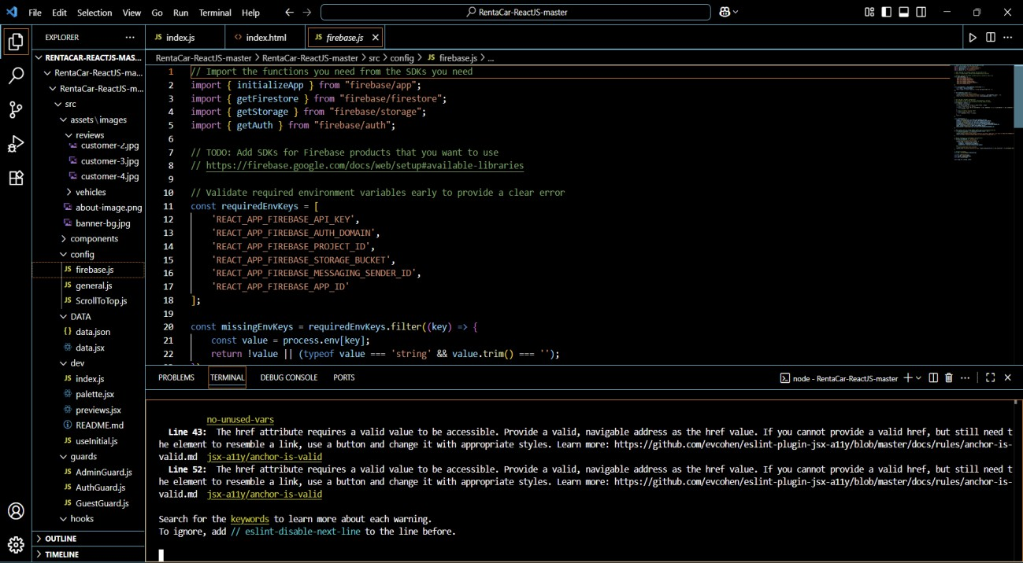
Chapter 5
Snapshots of the Project
5.1 Source Code Page

Slide 20
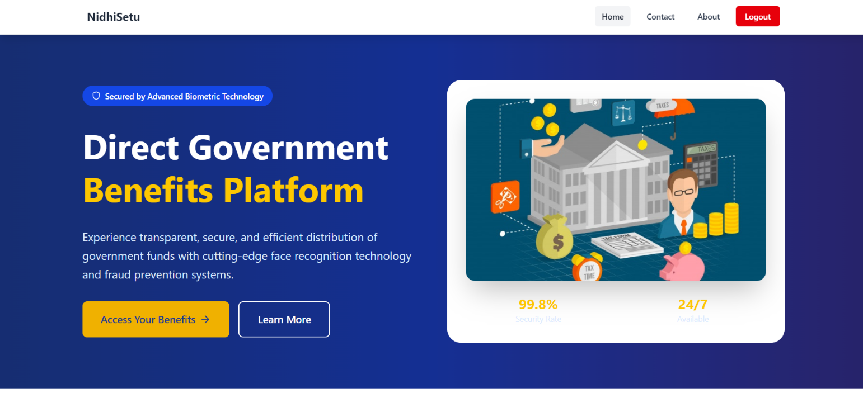
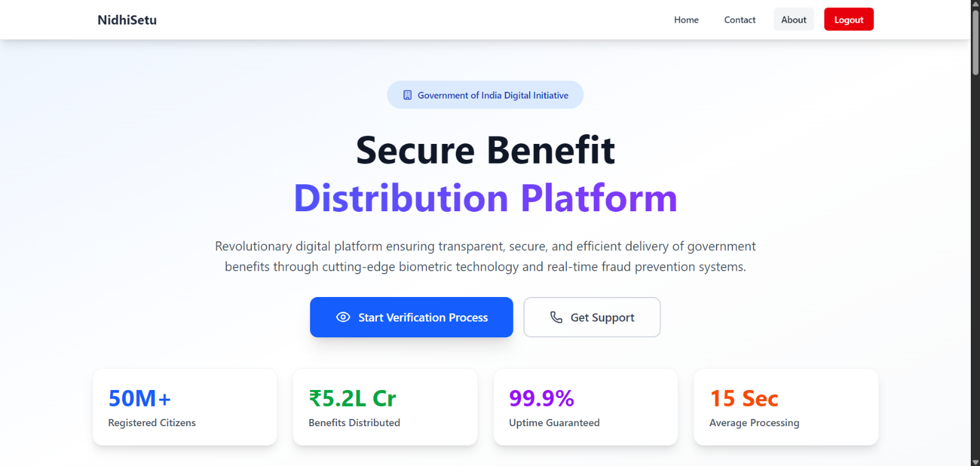
5.2 Home Page
5.3 About Page

Slide 21
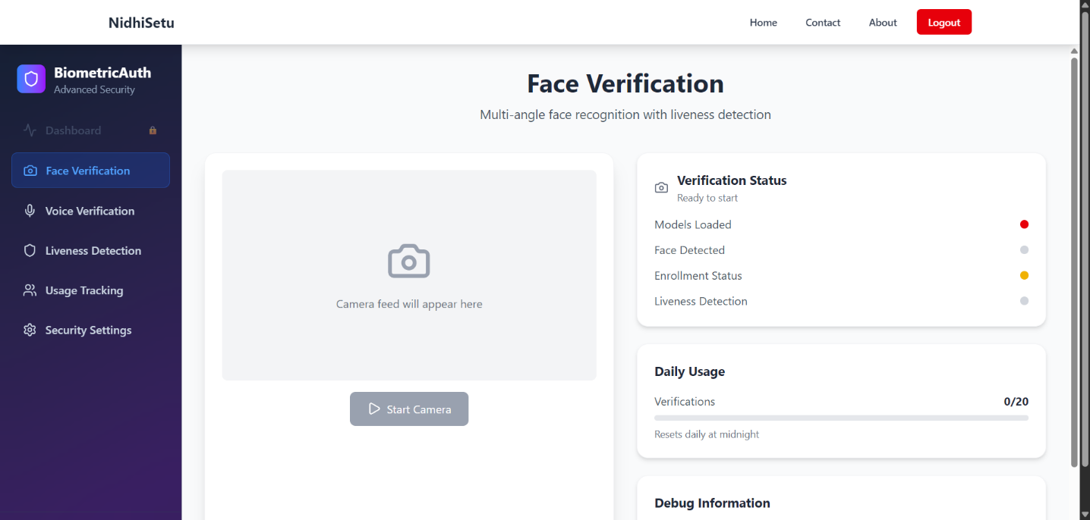
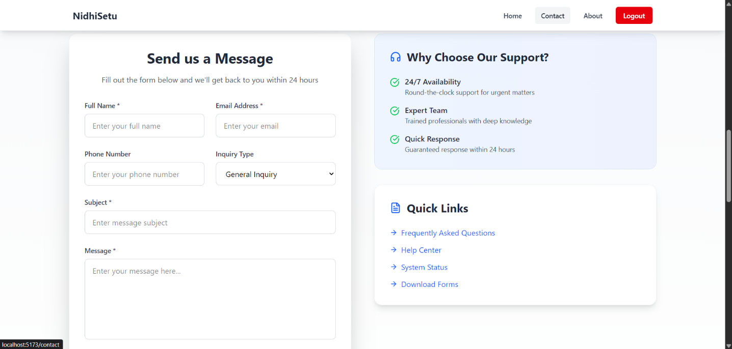
5.6 Client Page
5.7 Login Page

Slide 22
Chapter 6
Future Scope of the Project
The NIDHI-SETU project establishes a strong digital platform for bridging innovators and government funding opportunities efficiently. While the current system meets essential needs such as user authentication, project submission, and real-time verification, there remains vast potential for future enhancement. Integrating AI-driven recommendations, advanced analytics, and multilingual support can further enhance accessibility, transparency, and scalability for broader national adoption.
Integration of Secure Online Payment Gateway
Currently, the system allows customers to book vehicles without conducting actual online transactions. By integrating secure payment gateways such as PayPal or UPI-based systems, the platform can handle real-time financial transactions. This addition will allow users to pay while booking, automate payment confirmation, and generate digital invoices. Furthermore, integrating multiple payment options will enhance flexibility for users and make the system commercially viable for larger-scale operations.
GPS-Based Vehicle Tracking and Fleet Management
Integrating a real-time project tracking system in NIDHI-SETU can enhance transparency and efficiency. Innovators can monitor the status of their funding applications, while administrators gain better visibility into project progress. Adding automated alerts and dashboards will strengthen trust, ensure accountability, and improve overall system management.
Development of Dedicated Mobile Applications
Although the current web application is responsive on mobile devices, developing native mobile applications for Android and iOS can provide a smoother and more optimized user experience. Mobile apps can support push notifications for booking confirmations, reminders, discounts, and promotions. Offline access for vehicle information and quick booking options can also be included. A mobile-first approach ensures wider reach, faster performance, and higher user engagement.
Multi-Language Support and Accessibility Features

Slide 23
To expand accessibility, the system can be enhanced with multi-language support, enabling users from different regions to use the platform in their preferred language. Additionally, accessibility features such as screen reader compatibility, voice navigation, high-contrast UI, and keyboard navigation can be implemented to support differently-abled users. Such inclusivity increases the system’s usability and market reach.
Advanced Administrative Analytics Dashboard
Currently, the admin dashboard provides basic vehicle and booking management. Future improvements can include:
  Real-time sales reports and revenue analysis.
  Customer behaviour analytics to understand preferences and rental patterns.
  Fleet utilization insights to monitor vehicle usage and availability.
  Predictive analytics to forecast peak demand periods.
These advanced analytics tools will allow administrators to make data-driven decisions, optimize operations, and improve overall service quality.
Customer Reviews, Ratings, and Feedback System
Adding a feedback module will allow users to rate vehicles and provide comments on their experience. This system can include:
  Star ratings for vehicles and services.
  Reviews on vehicle condition, cleanliness, and service quality.
  Suggestions and complaints directly sent to administrators.
Feedback mechanisms help improve service quality, build customer trust, and provide actionable insights for continuous improvement.
Cloud Scalability and Performance Optimization
While the current system relies on Firebase for backend and real-time database management, future enhancements can involve:
  Cloud load balancing to handle large-scale user requests.
  Optimizing database queries for faster performance with a higher number of users and bookings.

Slide 24
Integration with scalable cloud services such as AWS, Azure, or Google Cloud to support enterprise-level deployment.
This ensures the system can accommodate growing user bases without performance degradation.
Integration of Artificial Intelligence and Machine Learning
Artificial intelligence (AI) and machine learning (ML) can significantly enhance the system’s intelligence and personalization:
  Personalized vehicle recommendations based on user history and preferences.
  Dynamic pricing models that adjust rental rates based on demand, seasonality, or special events.
  Predictive maintenance alerts for vehicles, helping administrators schedule servicing before breakdowns occur.
  Automated chatbots to handle customer queries, improving response time and customer satisfaction.
AI and ML can transform the system into a smart, automated, and highly efficient platform, providing competitive advantages in the car rental industry.
Integration with Third-Party Services
The system can be extended to integrate with third-party services for enhanced functionality:
  Navigation and mapping APIs for better route planning.
  Insurance services to automate vehicle insurance verification and claims.
  Travel and tourism services, allowing bundled offerings such as car + hotel bookings.
Such integrations increase the platform’s value proposition and create additional business opportunities.

Slide 25
Chapter 7
Conclusion
The NIDHI-SETU project, developed during the In-Person Corporate Internship at Seldom India Technologies, Jaipur, represents the practical implementation of the knowledge and skills acquired during the Full Stack Web Development Training Program. The project aims to create a secure, transparent, and efficient digital platform for automating the verification and disbursement process of government welfare funds.
The system integrates modern technologies such as React.js, Tailwind CSS, Node.js, Express.js, Firebase, Supabase, and Twilio AI to deliver a responsive, AI-powered, and cloud-enabled web application. Through this project, participants not only implemented full-stack development concepts but also gained hands-on experience in cloud integration, real-time database management, and AI-based authentication.
This chapter summarizes the key project outcomes, lessons learned, skills developed, limitations identified, and recommendations for future enhancements. It reflects on the overall training experience and the practical exposure gained during the development and deployment of the NIDHI-SETU system.
  Lessons Learned and Skills Developed Technical Skills
The NIDHI-SETU project offered an excellent platform to strengthen full-stack web development skills. Key technical competencies gained include:
Front-End Development: Designed responsive and interactive interfaces using React.js and Tailwind CSS, emphasizing reusable components and optimized performance.
Back-End Development: Developed RESTful APIs and server-side logic using Node.js and Express.js, ensuring efficient client-server communication.
Database Management: Implemented Firebase Firestore and Supabase for secure, real-time data storage, retrieval, and updates.
Authentication and Security: Integrated Firebase Authentication and AI-based identity verification for secure, role-based access control.
Cloud Integration and Deployment: Acquired experience in cloud hosting, database synchronization, and scalable architecture design.
Debugging and Optimization: Enhanced problem-solving skills by debugging code, optimizing workflows, and ensuring seamless integration across the full stack.

Slide 26
The development of the NIDHI-SETU project helped participants gain essential technical and professional competencies required for real-world software development.
Communication Skills
Apart from technical expertise, the project enhanced communication abilities:
Documenting project requirements, system workflows, and coding practices clearly.
Articulating technical issues, solutions, and project progress effectively to mentors and peers.
Presenting the project in a structured manner, including UI demonstrations, system flow, and backend operations.
Interpersonal and Professional Skills
The training also provided exposure to professional work culture, enhancing interpersonal skills:
Team Collaboration: Coordinating tasks, discussing solutions, and sharing knowledge with peers and instructors.
Time Management: Prioritizing development tasks, meeting project deadlines, and managing multiple modules simultaneously.
Critical Thinking: Identifying potential issues, analysing system requirements, and proposing effective solutions.
Overall, the project offered a holistic learning experience, combining technical, communication, and professional skills necessary for a successful career in software development.
7.2 Limitations and Recommendations
Limitations
While the Car Rental System successfully demonstrates full-stack development concepts, several limitations exist in the current implementation:
The system currently lacks online payment integration, limiting the booking process to non-transactional confirmations.
GPS-based vehicle tracking is not incorporated, which could enhance user experience and vehicle management.
Limited support for multi-language interfaces or accessibility features for differently- abled users.
Heavy reliance on Firebase services, which may have While the NIDHI-SETU System effectively showcases full-stack web development and AI integration, certain limitations exist in its current implementation:
The system currently lacks blockchain-based transaction recording, which could further enhance transparency and traceability.
Offline verification or low-connectivity support is limited, affecting accessibility in rural or remote areas.
The platform does not yet support multi-language interfaces or accessibility features for differently-abled users.

Slide 27
Although the current version of NIDHI-SETU effectively ensures secure and transparent fund disbursement, several enhancements can further improve its functionality and scalability:
Blockchain Integration: To enhance transparency and ensure immutable transaction records for all fund disbursements.
Multilingual Support: To make the platform accessible to users from diverse linguistic backgrounds across India.
AI Chatbot Assistance: To help beneficiaries with queries, verification guidance, and application status updates.
Advanced Analytics Dashboard: To provide administrators with visual insights, fraud detection metrics, and verification trends.
Scalability Optimization: To strengthen backend performance and database management for large-scale deployment.
By implementing these upgrades, NIDHI-SETU can evolve into a comprehensive, enterprise-level e-Governance platform, supporting large-scale government schemes and enhancing citizen trust through advanced digital innovation.

Slide 28
Chapter 8
References
8.1 Sample Reference Entries
Ogbiti, J. T., & Aaron, W. (2024). Development of a Web-Based Car Rental Management System. Science World Journal, 19(3), 797-807.
Bakale, S. C., Naware, A. M., Parab, S. V., & Anjaria, S. A. (2023). MERN Stack-Based Car Rental Website Development. International Journal of Advanced Research in Computer
Science, 14(2), 39-44.
Vasanthi, D., Sivasakthi, T., Abarna, V., & Arthi, R. (2021). Design and Development of Car Rental Website Using MERN Stack. Proceedings of the 2021 International Conference on Computing, Communication and Green Engineering (CCGE).
Osman, M. N., Zain, N. M., Paidi, Z., Sedek, K. A., & Yusoff, M. N. (2017). Online Car Rental System using Web-Based and SMS Technology. CRINN, 2, 277.
Xue, L., & Luo, S. (2018). The Design and Realization of Vehicle Rent Information System Based on Java. Open Access Library Journal, 5(9).
Seldom India Technologies. (2025). In-Person Corporate Internship Training Materials on Full-Stack Web Development. Jaipur, India.

Slide 29
THANKYOU

